Slide 1

Writing English Papers
《学术英语论文写作》
Lecturer: Liu Xindan

Slide 2

Chapter 2 Choosing a Topic

Slide 3
2.1 Principles of Title Selection
Your interest
Subject area
Availability of Resources

Slide 4
Topics to avoid
1. topics that are too big
2. topics based on a single source
3. topics that are too abstract
4. topics that are trivial
5. topics that are overused
6. topics that are contemporary

Slide 5
2.2 Methods for Choosing a Title
---Do literature review
--- Select from puzzling problems
---Choose from your own interest
--- Consult your professor or an expert
--- Participate in academic conferences and academic lectures
--- Read books and references

Slide 6
2.3 Principles of making a topic
Avoid a topic which is too broad (enough references)
Avoid a topic which is too narrow (in available time and space)
Avoid a topic which is grammatically incorrect

Slide 7
Use noun phrases
no infinitive verb phrase
no prepositional phrase (except “on”)
no sentences or phrases which are too long/
Eg. Planned and Unplanned Discourse Controlling Cultural Variations in the Preparations of TESOL materials

Slide 8
Key words should be included
eg. The hedging strategy in Chinese and English academic writing: A contrastive rhetoric perspective
Avoid “ A Study of “ pattern
eg. A study of text types
Text types: A systematic functional perspective

Slide 9
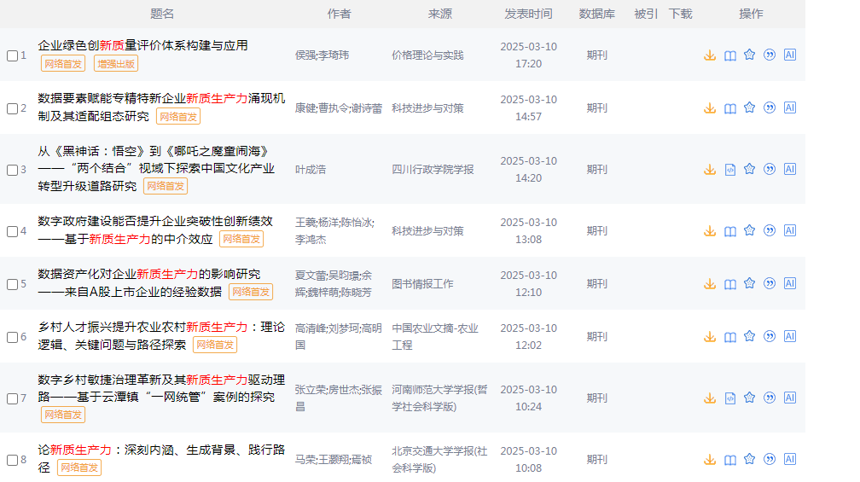
Tips for choosing a topic
1. 新题快做---新质生产力

Slide 10
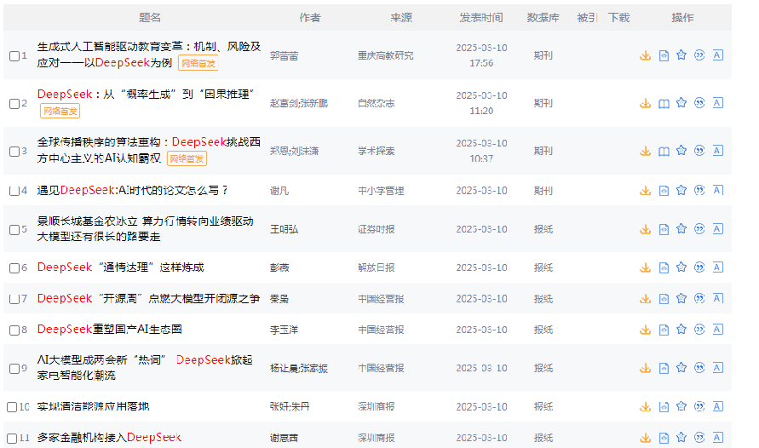
Tips for choosing a topic
1. 新题快做---DeepSeek

Slide 11
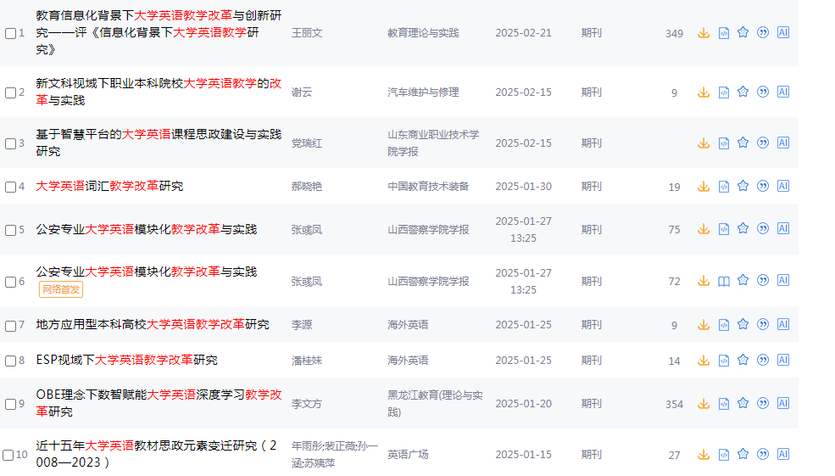
2. 旧题新做 特点：研究时间长，但不过时。 新思想、新视角、新方法

Slide 12
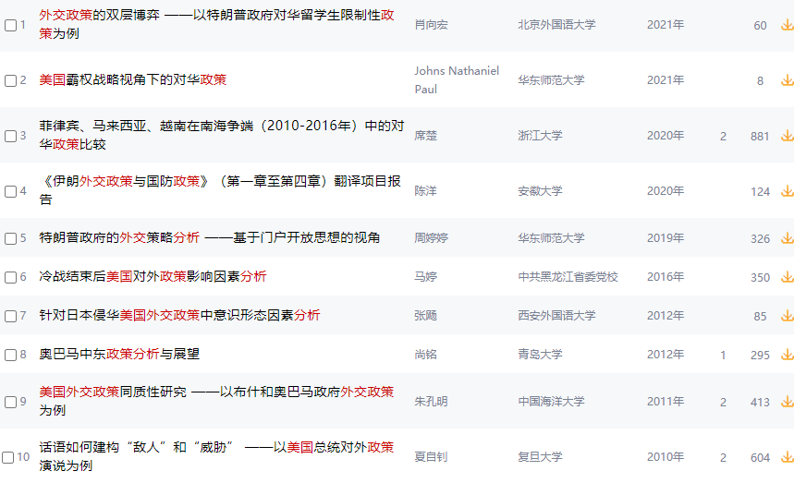
3. 大题小做，小题大做 做全、做精、做细

Slide 13
建议：
1. 看前看后 ：前人的研究成果，未来的发展方向
2. 看内看外：不要局限于国内的研究，要多参考国外的研究成果
3. 看左看右：近几年论文选题动向

Slide 14
Ways to Narrow down Titles
Broad: Climate Change
Narrowed: The Impact of Rising Sea Levels on Property Values in South Florida (2010-2020)
Broad: Social Media Effects
Narrowed: The Relationship Between Instagram Use and Body Image Dissatisfaction in Adolescent Girls

Slide 15
Ways to Narrow down Titles
1）Chemistry
Chemical Processes
Improving Chemical Processes
Oxygen in Improving Chemical Processes
Role of Oxygen in Improving Chemical Processes
2）Translation
Factors in Translation
Cultural Factors in Translation
Cultural Factors in Translation and Their Transfer

Slide 16
2.4 Standards for Good Titles
---Accuracy
---Brevity
---Clarity

Slide 17
2.4 Standards for Good Titles
Accuracy
Words choices should be accurate and reflect the actual situation.
Original title:
Development and Exploration on the Utilization of New Resources for the Countryside
Revised title:
Utilization of Marsh Gas for the Countryside

Slide 18
2.4 Standards for Good Titles
Brevity
Using the most succinct text possible to summarize the contents.
Original title:
On the Addition to the Method of Microscopic Research by a New Way of Producing Colour-Contrast Between an Object and Its Background or Between Definite Parts of the Object Itself
Revised title:
A New Way of Producing Colour-Contrast in Microscopic Examination

Slide 19
2.4 Standards for Good Titles
Clarity
The title should clearly reflect the subject of the paper.
Eg.
Incorporation of a Non-Human Glycan Mediates Human Susceptibility to a Bacterial Toxin

Slide 20
Exercise Evaluate the following titles against the criteria for a good title
1. The Acquisition of English
2. AI and the Computer Science
3. A Study on the Effects of Climate Change on Agricultural Productivity
4. The Color Blue: A Comprehensive Analysis of Its Psychological and
Emotional Impact on Human Moods and Feelings
5. The Effects of Light and Temperature on the Growth of
Populations of the Bacterium
6. A Comparison of News Reports on the 2012 London Olympics
between Domestic and Foreign Media

Slide 21
2.5 Formats for Title
Examples:
1) OSCILLATIONS IN GRANULAR DYNAMICS
2) Structural Analyses Based on a Point Charge Model
3) Coronary artery disease: diet and patient health

Slide 22
Upper Case and Lower Case in Titles
1.题目的第一个单词首字母，最后一个单词首字母要大写；
2.冠词都不需要大写；
3. 一般实词（名词、动词、代词、形容词、副词）首字母大写，虚词（介词、冠词、连词）和不定式中的 to首字母小写。
Eg. On American’s Negative Attitude Towards Chinese Culture in Mass Media

Slide 23
4. 字母多于四个(不含四个)的介词、连词首字母要大写，如between、without、alongside、underneath等； Eg. An Analysis on the Differences of Tourism Talents Training Between China and United States
5. 大写所有英语中要求大写的单词。如月份、人名、地名等等。
Eg. The Differences of Mulan’s Image Between China and America from the Perspective of Cultural Values

Slide 24
6. 复合词，如：well-known的大写形式应为Well-Known.
7. 标题末一般不加标点符号，但如果标题是直接问句，需要加问号。
8. 文章中引用书刊标题时应用斜体，引用文章标题应加引号。
这几条原则的优先性是递减的，也就是说，如果几条原则之间出现了矛盾的情况，应优先实用前面的原则。如：如果题目的第一个单词是冠词或不多于三个字母的介词时也应该大写。
Eg. Julien’s Love Tragedy in the Red and the Black: A Social Class Perspective

Slide 25
9. 作者的姓名 国外作者： 名+中间名+姓 中国作者：姓名分开写 如，Li Xiaomin 或， LI Xiaoming 有些著名杂志还要加上会员名称 如，IEEE 电气电子工程学会 IRE 无线电工程师协会
J.C.HELMER, STUDENT MEMBER, IEEE AARON A. GALVIN, MEMBER, IRE

Slide 26
Exercise: Correct the mistakes of format in the following topics
1. Language Policy of France and Its Insight Into the Protection of Chinese Dialects
2. An Analysis on Yang Xianyi and David Hawks’ Translation of Registered Poems in “A Dream in Red Mansions” from The Perspective of Functional Equivalence
3. Analysis on the Application of Chinese-style Teaching in British Bohunt Middle School From the Documentary Are Our Kids Tough Enough

Slide 27
Exercise Correct the mistakes of format in the following topics
1. Language Policy of France and Its Insight Into the Protection of Chinese Dialects
2. An Analysis on Yang Xianyi and David Hawks’ Translation of Registered Poems in “A Dream in Red Mansions” from The Perspective of Functional Equivalence
3. Analysis on the Application of Chinese-style Teaching in British Bohunt Middle School From the Documentary Are Our Kids Tough Enough

Slide 28
The End

